Slide 1



DATA WRANGLING SCRAPING AND ANALYSIS OF AMAZON PRODUCT REVIEWS
Team Members:
- Usha Kiran Bellam (ub39)
- Shourya Thatha Ravi (st1037)

Slide 2
AGENDA
Introduction and comparison
Web scraping of different product Reviews
Saving and loading data
Rshiny User Interface
Data Cleaning
Calculation of normalize and aggregated metrics
Word Cloud
Afinn lexicon ratings comparison
Bing lexicon ratings comparison
NRC lexicon sentiments comparison
Conclusions

Slide 3
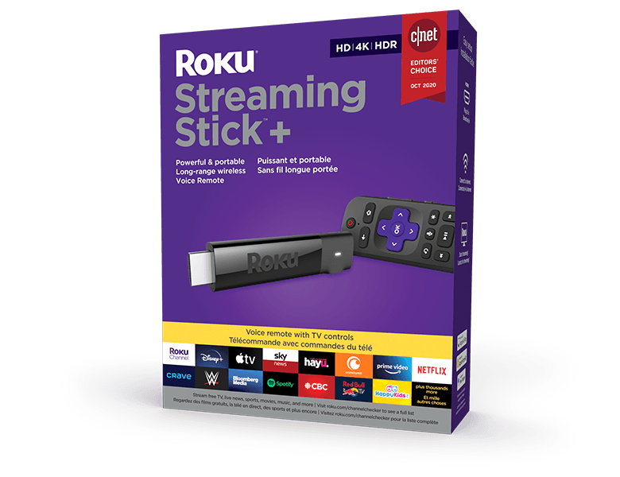
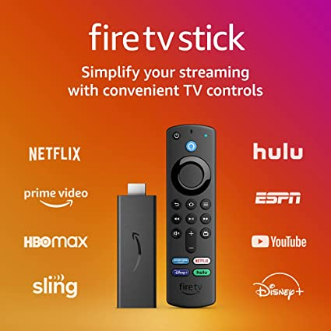
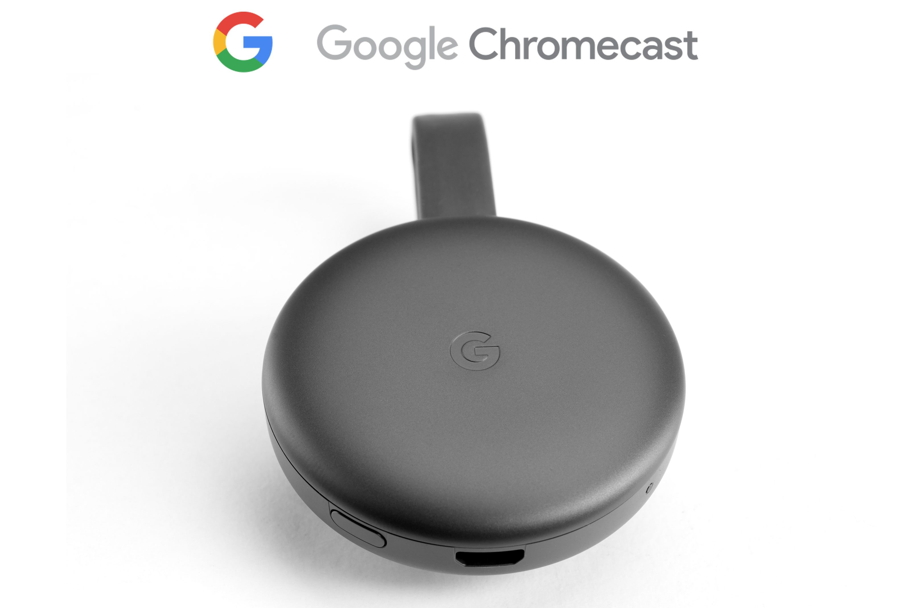
Introduction and comparison
Obtain sentiments from reviews and predict ratings
Generalize the methodology on different products

Slide 4
Web scraping for Amazon Firestick reviews
3 different products to compare and analyze: Amazon Firestick, Roku, Google Chromecast
Scraping 500 pages for each product
Declared user-defined functions for code reusability
Amazon Firestick
Product ID: B07YNLBS7R
Libraries used: rvest, tidyverse, httr, curl, jsonlite

Slide 5
Web scraping for Google Chromecast reviews
Google Chromecast
Product ID: B015UKRNGS

Slide 6
Web scraping for Roku reviews
Roku streaming stick
Product ID: B075XLWML4

Slide 7
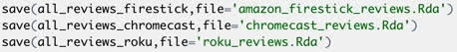
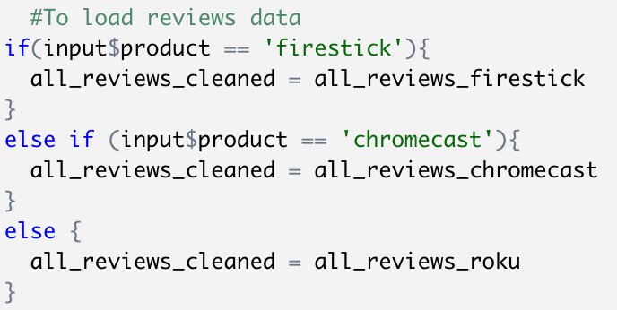
Saving and loading data (Time constraint)
Save dataframe as R objects - .Rda files
Load data to workspace
Assign variables according to input
Library used: rio

Slide 8
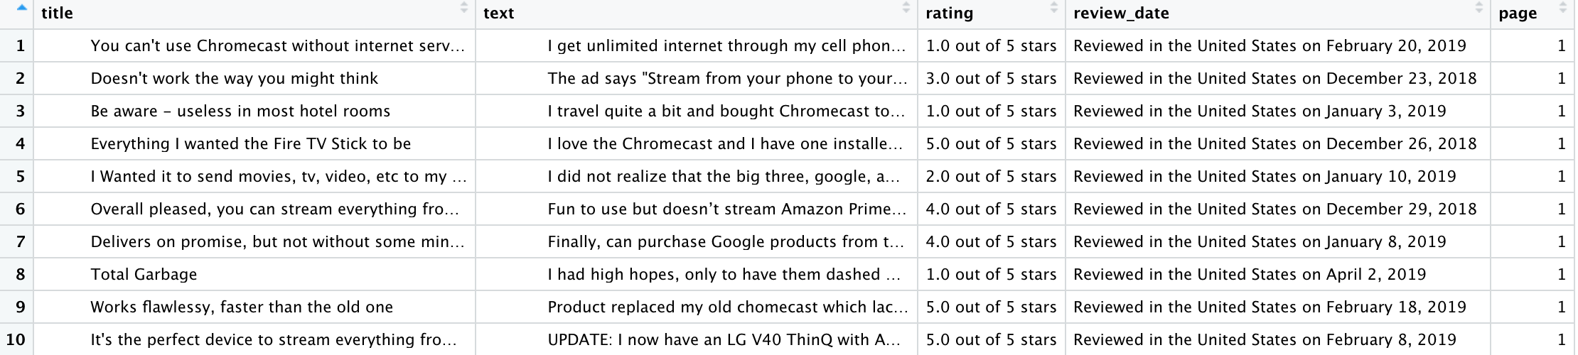
View of reviews data
Cleaning all columns from the scraped data

Slide 9
Rshiny User Interface
Drop downs for products, chart type and lexicons
Radio buttons for date level selection
Libraries used: shiny, shinythemes

Slide 10
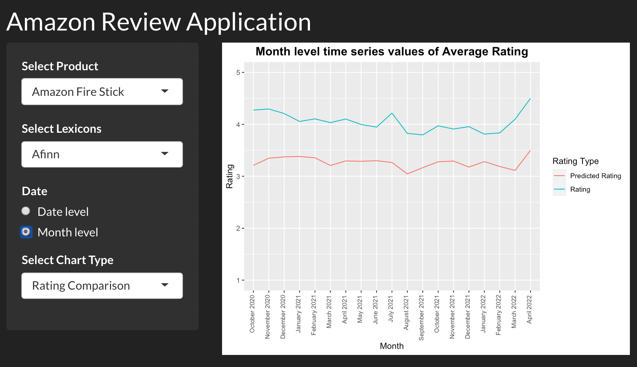
Shiny Application

Slide 11
Data Cleaning
Cleaning text data for each review using str_replace_all
Cleaning date to get the right format

Slide 12
Data Cleaning
Creating year, month and day columns
Creating the final date column
Sorting the date in descending order
Libraries used: lubridate

Slide 13
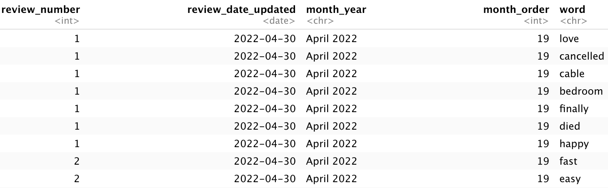
Review number and tokenizing
Adding review number to each review using row_number()
Rating is calculated at review number level
Tokenizing and removing stop words
Libraries used: tidytext

Slide 14
Remove product specific words
Checking common words and word count
Removing product specific words – replace with NA

Slide 15
Word cloud for Amazon Fire Stick, Google Chromecast and Roku
Amazon Fire Stick
Google Chromecast
Roku Streaming Stick

Slide 16
Calculated aggregated score for each review using Afinn lexicon
Afinn lexicon returns value for each word between -5 to 5
For a review, Aggregated score = sum of Afinn values of words / number of words
For a review, aggregated score is used to calculate the predicted rating

Slide 17
Normalizing and Correlation
Min_old = -5 Min_new = 1
Max_old = 5 Max_new = 5
Re-scaling formula to convert -5 to 5 scale to a 1-5 scale
Join with actual ratings table and compare predicted rating with the actual rating
 | Amazon Fire Stick | Google Chromecast | Roku
Correlation (Predicted Rating and actual rating) | 0.43 | 0.52 | 0.41

Slide 18
Day level comparison of actual rating and predicted rating from Afinn
For each day, average rating of both predicted and actual ratings are calculated and compared.
For Amazon Fire Stick, Predicted rating from Afinn is lower than the actual rating

Slide 19
Month level comparison of actual rating and predicted rating from Afinn
For each month, average rating of both predicted and actual ratings are calculated and compared.
Amazon Fire Stick
For Amazon Fire Stick, Predicted rating from Afinn is lower than the actual rating

Slide 20
Product comparison of actual rating and predicted rating (Afinn)
Google Chromecast
Roku Streaming Stick
Across products, predicted rating from Afinn is lower than the actual rating

Slide 21
Calculated positive percentage for each review using Bing lexicon
Bing lexicon returns ‘positive’ or ‘negative’ for each word
Using pivot_wider, negative and positive columns are created
For a review, positive_perc is used to calculate the predicted rating

Slide 22
Normalizing and Correlation
Min_old = 0 Min_new = 1
Max_old = 1 Max_new = 5
 | Amazon Fire Stick | Google Chromecast | Roku
Correlation (Predicted Rating and actual rating) | 0.54 | 0.59 | 0.55
Above Re-scaling formula is used to convert positive percentage scale to a 1-5 scale

Slide 23
Day level comparison of actual rating and predicted rating from Bing
For each day, average rating of both predicted and actual ratings are calculated and compared.
The predicted rating calculated from Bing is close to the actual rating than the predicted rating from Afinn.

Slide 24
Month level comparison of actual rating and predicted rating from Bing
For each month, average rating of both predicted and actual ratings are calculated and compared.
Amazon Fire Stick
The predicted rating calculated from Bing is close to the actual rating than the predicted rating from Afinn.

Slide 25
Product comparison of actual rating and predicted rating from Bing
Google Chromecast
Roku Streaming Stick
Bing does a better job predicting ratings for Google Chromecast and Roku than Amazon Fire Stick

Slide 26
Calculated aggregated Sentiment Percentage at day level using NRC lexicon
For a day, Sentiment percentage = number of words for a sentiment in the day / total number of words in the day

Slide 27
Calculated aggregated Sentiment Percentage at month level using NRC lexicon
For a month, Sentiment percentage = number of words for a sentiment in the month / total number of words in the month

Slide 28
Calculated aggregated Sentiment Percentage for all reviews using NRC lexicon
Amazon Fire Stick
Positive, Trust, Negative, Anticipation and Joy are the top sentiments in Amazon Fire Stick Reviews

Slide 29
Across products the top sentiments remained the same
Google Chromecast
Roku Streaming Stick
The order of top sentiments changed slightly

Slide 30
Performed regression and weighted regression to see if rating can be predicted based on the sentiments from NRC
Applying weights based on recency only increased the R-squared marginally

Slide 31
CONCLUSIONS
Observations
Out of Afinn and bing lexicons, Bing’s Day wise and Month wise predicted average ratings has less deviation with the actual average ratings.
The models can be generalized to scenarios where ratings are not available.
Good correlation score was achieved between predicted and actual ratings.
Future Implementations
Retrieving greater number of reviews can lead to better model performance (currently 5000 reviews)
Removing multicollinearity during regression modelling

